Slide 1
Notes:
Start off dark
Hook:
Juvenal Hey Bay Air E Man Ahh
April 6, 1994 Rwandan President Juvenal Habyarimana, a Hutu, was shot down above Kigali airport on 6 April 1994.
In 100 days, 800,000 to 1 M (perhaps even 2 M) Tutsi and moderate Hutus were slaughter.
6 men, women and children were murdered every minute of every hour of every day for 3 months
Source: http://survivors-fund.org.uk/resources/rwandan-history/statistics/
Rwanda size of Maryland with 7.7M pop in 1991
>10% killed
http://worldwithoutgenocide.org/genocides-and-conflicts/rwandan-genocide
Int’l comm inadequate response
Did the world see this coming?
How do we prevent?

Slide 2
Preventing genocide
Using Data Science to identify early indicators of Future State led mass killings
2017-04-26
DS-SEA-06
Mark Cotton
Notes:
Post WWII HC, many mass killings
Classified Genocides:
Rwanda, Cambodia, and Bangladesh
Slaughter of millions of people
GenocideWatch.org: Genocides and other mass murders killed more people in the twentieth century than all the wars combined.
Unfort, easy to recognize after
Challenge: How prevent?
Min Death # before respond?

Slide 3
What can be done to prevent Genocide?
From the Genocide Prevention Task Force
    The first major element of a comprehensive system to prevent genocide and mass atrocities is a reliable process for accessing risks and generating early warning of potential atrocities... Effective early warning does not guarantee successful prevention, but if warning is absent, slow, inaccurate, or indistinguishable from the 'noise' of regular reporting, failure is virtually guaranteed.
Genocide is nearly always carried out by a country’s own military and police, requiring external prevention.
Watch for state-led mass killings
Research question:
Can a model be created to predict likelihood of state led mass killings?
Notes:
Source:
http://www.earlywarningproject.com/about
1000+ non-combatant civilians killed in country of over 500,000 by state in 12 month time period

Slide 4
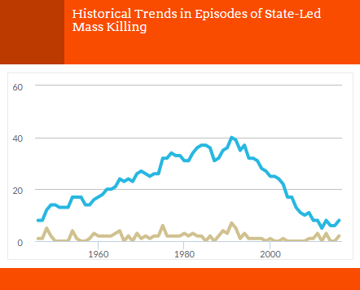
Where is the data from and what is it?
EarlyWarningProject.com is running statistical risk assessment with the goal of preventing mass atrocities
Data from publicly available sources and cleaned:
  178 countries
  From 1945-2014

Slide 5
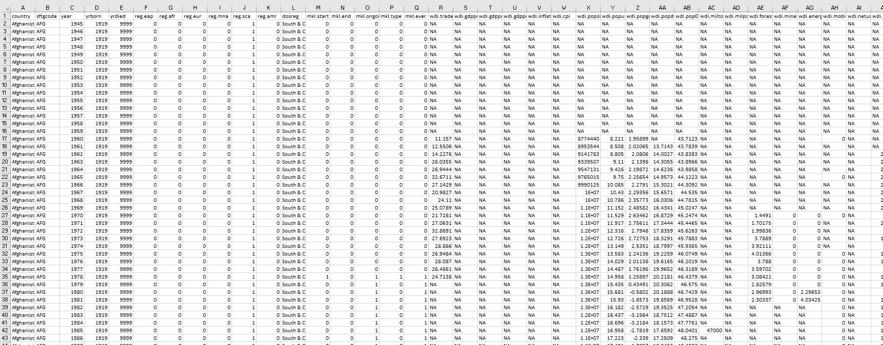
View the data
276 Variables 9163 Observations
Notes:
Birth year of country?
GDP?
Fractionalization?:
Lingual (elf_language)
Religious
Ethnic
Collapse of democratic institutions?
Violence associated with regime transition?
Democracy score? (pol_democ)b
Large supply of natural resources? Oil, gold, diamonds, etc.
Not sure oil is in the data or specific types of minerals.
Mineral depletion (wdi_minerals)
Forest depletion (wdi_forest)
Energy depletion (wdi_energy)
Trade openness (wdi_trade)
Context in which state-led mass killing episode began (mkl.type)
none
civil war
uprising
repression
other

Slide 6
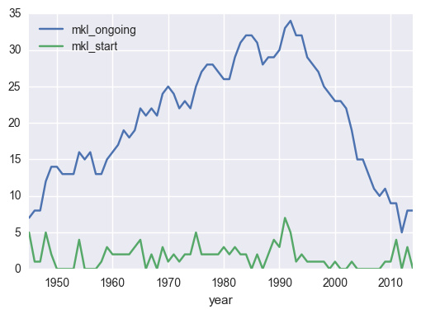
What have you done with the data?
Imported data and begun exploring
  Looking at countries with history of state-led mass killings
  Exploring features

Slide 7
Open questions
What is common between countries that experienced state-led mass killings?
Why has the number of ongoing state-led mass killings dropped since 1992?
Did this model predict high likelihood for ongoing atrocities in Syria?
What are the features that are the key predictors for a country having new state-led mass killings?

Slide 8
Thank you!
Notes:
International genocide definition:
Under the 1948 UN Convention on the Prevention and Punishment of the Crime of Genocide, genocide means “any of the following acts committed with intent to destroy, in whole or in part, a national, ethnical, racial or religious group, as such:
(a) Killing members of the group;
(b) Causing serious bodily or mental harm to members of the group;
(c) Deliberately inflicting on the group conditions of life calculated to bring about its physical destruction in whole or in part;
(d) Imposing measures intended to prevent births within the group;
(e) Forcibly transferring children of the group to another group.”

Slide 9
What data have you gathered, and how did you gather it?
Which areas of the data have you cleaned, and which areas still need cleaning?
What steps have you taken to explore the data?
What insights have you gained from your exploration?
Will you be able to answer your question with this data, or do you need to gather more data (or adjust your question)?
How might you use modeling to answer your question?

